Slide 1
Project Presentation
Uday T
181046016
Big Data and Data Analytics

Slide 2
Guided by:
Company Details
NOKIA NETWORKS Silver Oak, L5 Building, Manyata Tech Park, Nagavara, Bengaluru, Karnataka 560045
External Guide:
Ravi Rajaram
R&D Specification Specialist
System Performance, NetAct
Nokia Networks
Internal Guide:
Arockiaraj S
Assistant Professor
MSOIS, MAHE
Manipal

Slide 3

Predictive Analysis and Development of Dimensioning Tool

Slide 4
Contents
Introduction
Problem Statement
Implemented use-cases
Tools and libraries used
References
Challenges Faced
Project Applications
Edification through the project

Slide 5
NetAct
Introduction (Prerequisites)
Nokia NetAct is a new generation network management system for multi-vendor and multi-technology networks.
NetAct serves both as a network management system and as an element management system.
It is designed for handling an increase in both complexity of the network and the amount of traffic and data.

Slide 6

System Performance
The System Performance team is responsible for executing various test-cases and test-environments in simulation before deploying the build/version/upgrade to a customer.
This teams ensures that there are no escape defects from R&D development to customers.
These tests ensure that the customer faces no issues when they deploy NetAct.

Slide 7
Greenfield and Capacity Increase
Greenfield:
Greenfield deployment is where a completely new Network along with NetAct is deployed in the customer site.
Network Expansion:
When customers wants to increase their existing capacity by adding new Network elements due to the new user.

Slide 8
Dimensioning Tool
Dimensioning tool is used when deploying NetAct to customer site.
It stores tabulated data of several KPIs for different configurations.
Using KPI estimation on the dimensioning tool, the NetAct vendors can provide customers with the optimal type of supported configuration.

Slide 9
Problem Statement
The aim of this project is to integrate predictive analytics to NetAct dimensioning tool in order to assist the customer when deploying NetAct for greenfield or capacity increase.
This includes:
Performing exploratory data analysis on various tests that are being conducted in NetAct simulators and customer labs.
Tabulating data and inferences for different tests and configurations.
Applying predictive analysis on the tabulated data.

Slide 10
Project Workflow
Data collection from Zabbix and Grafana
Data pre-processing & cleaning
Statistical and Exploratory data analysis
Data Tabulation
Predictive Analysis
Integrating to Dimensioning Tool
Stability or Load configuration tests on NetAct simulators
Data Visualization

Slide 11

Implemented use-cases
Stepwise UI load tests
Correlation Analysis
Raw and Aggregated Data analysis
Peak Usage measure

Slide 12
Peak Usage Measure
The task is to measure the peak usage of a metric at regular intervals.
Gives a overview of active time used to perform an operations.
This peak usage is tabulated for various labs and different configurations.

Slide 13

Process
CPU usage of different virtual machines is collected.
Based on the interval in which the counters are sent, A time group is created.
The minimum CPU usage is observed and set as threshold.
Total number of minutes CPU stays above threshold is recorded for different VMs and NetAct configurations.

Slide 14
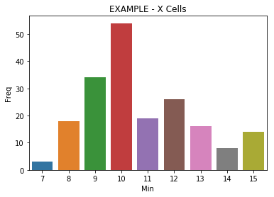
ANALYSIS
VMwise Graph
X-axis – Observed N^{th} Minute
Y-axis – Number of times CPU was above 20% for N^{th} Minute
Inference: For X cells at every interval,
The most number of times CPU stayed greater than 20% was 10 Minutes

Slide 15
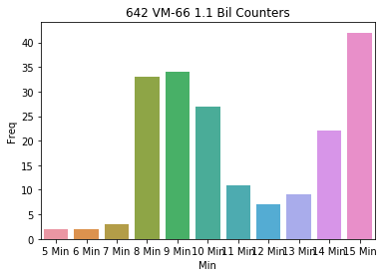
LAB 1
Counters: | 190 Mil | 280 Mil | 380 Mil
VM 66 | 1 min | 1 min | 2 min
VM 67 | 1 min | 1 min | 1 min
VM 68 | 1 min | 1 min | 2 min
VM 69 | 1 min | 1 min | 2 min
Peak Value | 1 MIN | 1 MIN | 2 MIN
LAB 3
LAB 2
Counters | 640 mil | 800 mil | 950 mil
VM 66 | 7 min | 8 min | 9/8/10 min
VM 67 | 7 min | 8/9 min | 10 min
VM 68 | 7 min | 9/8 min | 10 min
VM 69 | 7 min | 8/9 min | 10/9 min
Peak Value | 7 MIN | 8 MIN | 10 MIN

Slide 16
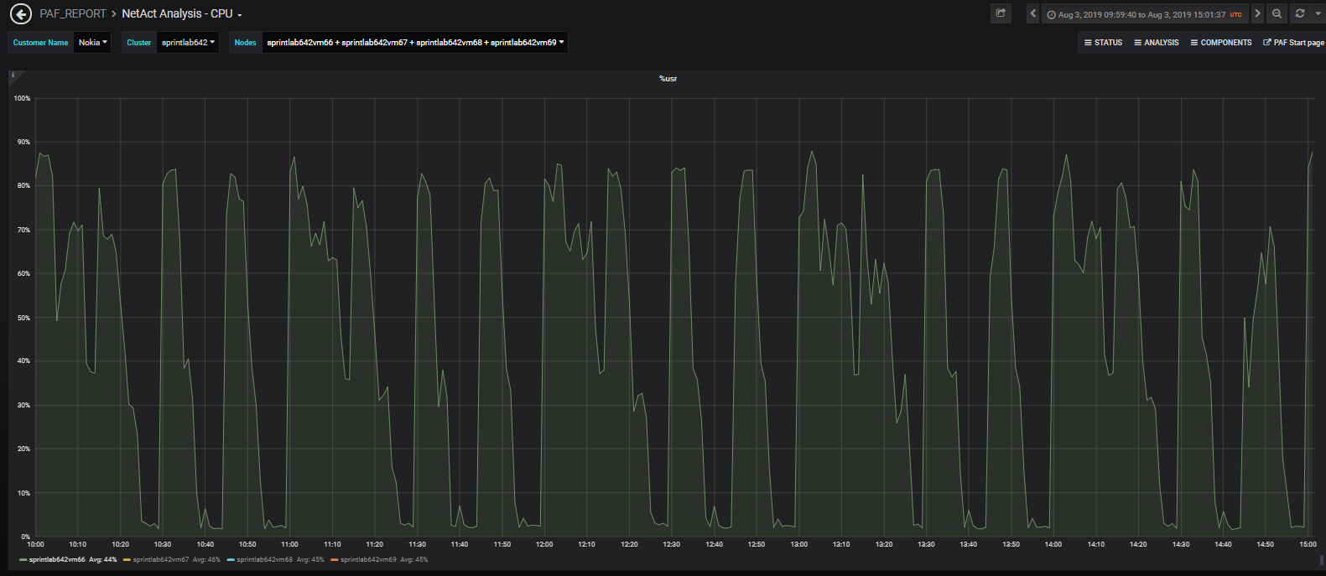
LAB 3
LAB 3 couldn’t process the 60 min + 15 min counters hence peak measure can’t be accurately predicted

Slide 17
Correlation Analysis
Metrics:
IOPS (Input and Output operations), Throughput (Disk read rate and Disk write rate) and Counters.
The data of the above metrics is compared for different labs.
Pattern of sending the data is observed for different labs.
5 min, 15 min, 30 min and 60 min counters

Slide 18
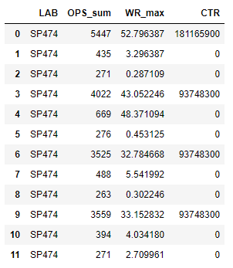
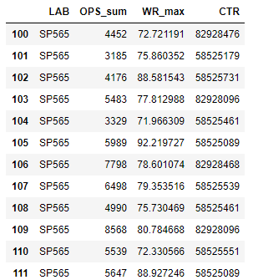
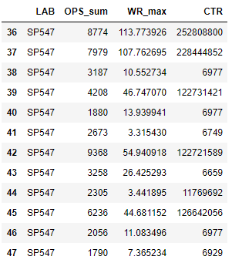
Counters pattern (In 5 minute Interval)
Min 0 5 10 15 20 25 30 35 40 45 50 55
LAB 1 - 460 Mil CTR
LAB 2 - 900 Mil CTR
LAB 3 - 800 Mil CTR

Slide 19
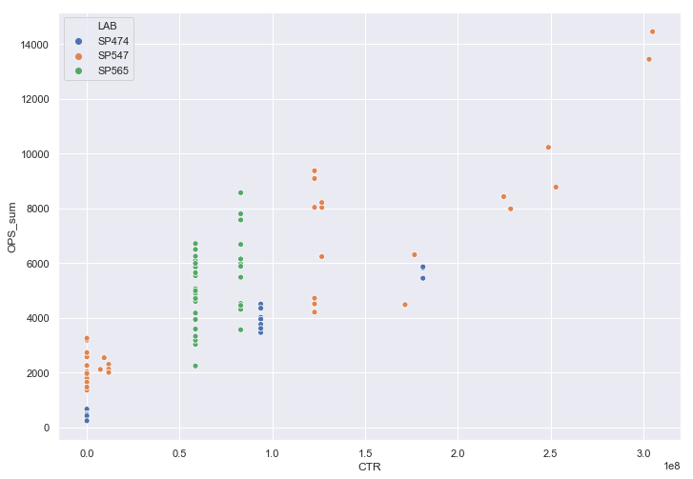
IOPS (sum of 5 Min) vs Counters (5 Mins)
In 474, there are 2 types of counters (4*15 min + 1* 60 min). All the counters are processed in the first 5 minutes.
In 565 there are 2 types of Counters (12*5 min and 4*15 min), Hence we see 2 clusters that are grouped nearby.
547 has similar pattern as 474 but the takes more time as total counters are higher.

Slide 20
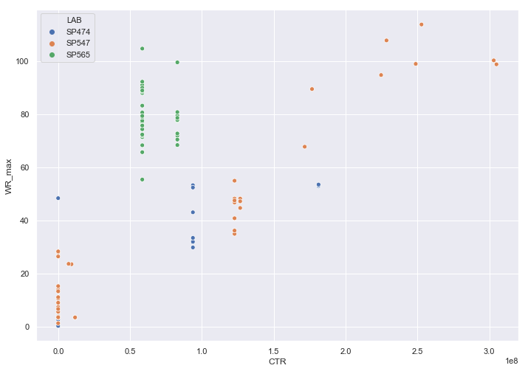
Disk Write Rate (Throughput) vs Counters (5 Minutes)
We can see that there is a linear increase in Disk write rate with increase in counters in 474.
Higher disk write rate is observed in 565 due to counters being sent at every 5 minute interval.
547 lab always consumes very high disk write rate in the first 15 minutes.

Slide 21
Stepwise UI Load Tests
NetAct monitors are launched stepwise and data of metrics is recorded.
CPU usage is compared for different NetAct configurations.
Response time of various operations is captured.

Slide 22
Process
Launching ‘n’ NetAct monitors at every step and monitoring the CPU of WAS and DB nodes.
Stepwise tests are conducted on different NetAct configurations.
Response time of several operations like (Ack, Unack, Upload and Filtering of Alarms) was tabulated
Minimum, average and maximum levels of CPU was recorded in the tests at every interval.

Slide 23
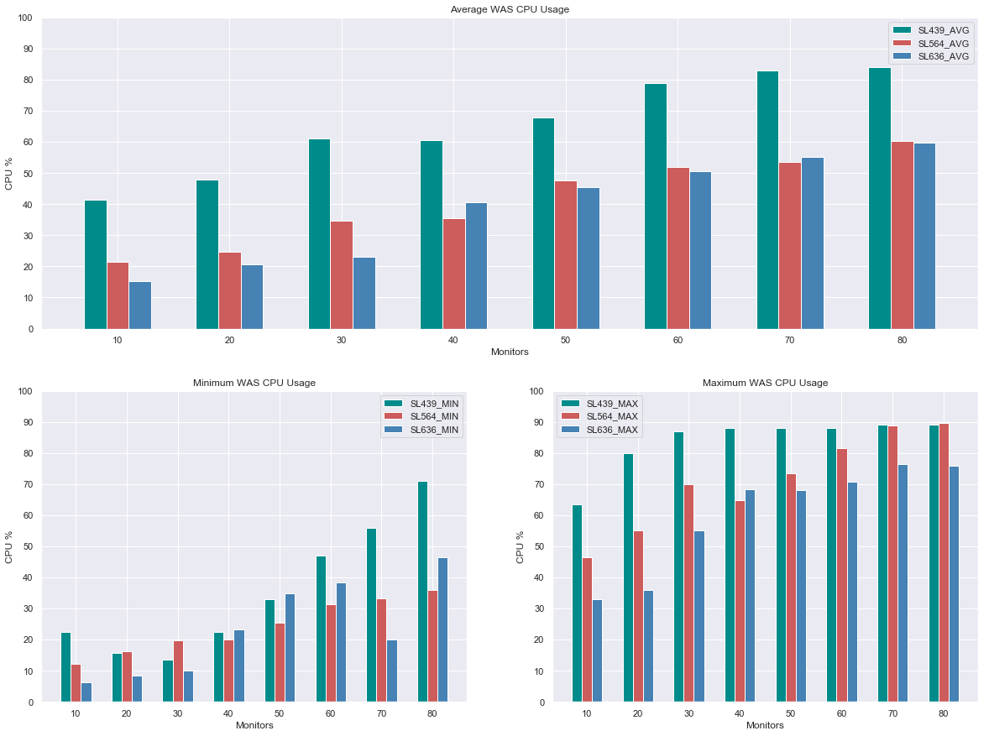
WAS CPU Usage Avg, Min and Max Config: SL439 – Small SL564 – Large SL636 – XXL

Slide 24
Response Time while performing monitor operations (in seconds) XXL configuration
 | 20 Monitors | 40 Monitors | 60 Monitors | 80 Monitors
ACK | 1 | 2 | 2 | 2
UNACK | 1 | 1 | 1 | 1
Cancel | 2 | 2 | 2 | 2
Maintenance | 1 | 1 | 1 | 1
Resume | 17 | 22 | 20-22 | 23
Alarm Upload | 6 | 6 | 8 | 6, 39
Alarm Filter | 18 | 20 | 12 | -

Slide 25
Raw and Aggregated Disk Usage
Disk usage data is collected by conducting a pre configured test
Using the test data a relationship between Raw and Aggregated data is obtained:
Raw disk usage estimation.
Raw vs Aggregated Total
Aggregated Total vs Other Aggregations.

Slide 26
Process
A requirement specific test was conducted and data was collected for various use-cases.
Data of several network adaptations are collected in some labs.
Check if the ratio of RAW data vs Aggregated data is correlating with the measurement intervals.
Obtaining other Aggregations using AGG Total.

Slide 27
RAW disk usage estimation using Counters
 | Adaptation | Counters | Actual Disk Usage | Predicted Disk Usage | Error | Equation
petslab255 | NOKMRN | 1052241533 | 19548 | 21737.07854 | -2189.078544 | Counters * 0.0000206578792628333
 | NOKRWW | 4439850048 | 28045.1875 | 28076.70881 | -31.52130585 | Counters * 0.0000063237966377931
 | NOKBSC | 2837682000 | 17693.4375 | 17778.65099 | -85.21349244 | Counters * 0.00000626520201785947
 | NOKLTE | 7561385016 | 41656 | 51485.89579 | -9829.895794 | Counters * 0.00000680905623571728
 | XMLNSS | 445528699 | 5449 | 4259.254362 | 1189.745638 | Counters * 0.00000956
SL487 | NOKMRN | 1332576000 | 31136 | 27528.19412 | 3607.805883 | Counters * 0.0000206578792628333
 | NOKRWW | 2250572468 | 14001 | 14232.16261 | -231.1626062 | Counters * 0.0000063237966377931
 | NOKBSC | 1337380802 | 8264.25 | 8378.960899 | -114.7108993 | Counters * 0.00000626520201785947
 | NOKLTE | 2711520000 | 20684.875 | 18462.89216 | 2221.982836 | Counters * 0.00000680905623571728
 | XMLNSS | 223609441 | 2790.6875 | 2137.706256 | 652.981244 | Counters * 0.00000956
 | NOKGNB | 1700784000 | 13155 | 12115.5294 | 1039.470603 | Counters * 0.0000071234968093653
SL439 | NOKMRN | 666288000 | 15534 | 13764.09706 | 1769.902942 | Counters * 0.0000206578792628333
 | NOKRWW | 1109962512 | 7139.375 | 7019.177201 | 120.1977985 | Counters * 0.0000063237966377931
 | NOKBSC | 660014600 | 4159.8125 | 4135.124804 | 24.68769626 | Counters * 0.00000626520201785947
 | NOKLTE | 1768560000 | 13427 | 12042.2245 | 1384.775504 | Counters * 0.00000680905623571728
 | XMLNSS | 66721112 | 865.5 | 637.8538307 | 227.6461693 | Counters * 0.00000956
 | NOKGNB | 850392000 | 6655 | 6057.764699 | 597.2353013 | Counters * 0.0000071234968093653

Slide 28
RAW data vs Aggregations Test Data:
Type |  | 642 | 522 | 439 | 487 | 636
RAW | NOKMRNRAW
AGG Total | NOKMRN | 4.584433663 | 4.574113407 | 19.76433172 | 2.937498044 | 6.780901097
RAW | NOKRWWRAW
AGG Total | NOKRWW | 1.289808749 | 1.265854816 | 1.246519443
RAW | NOKBSCRAW
AGG Total | NOKBSC | 1.028071279 | 1.011217812 | 0.979345955
RAW | NOKLTERAW
AGG Total | NOKLTE | 3.160862131 | 3.094639214 | 2.060558533 | 0.784347167
RAW | NOKGNBRAW
AGG Total | NOKGNB | 3.146966312 | 2.971323228 | 8.598094623 |  | 3.148304083
Ideal Raw : Aggregation ratio:
1 = 60 min counters, 2 = 30 min counters, 4 = 15 min counters

Slide 29
Aggregated Total vs Other Aggregations
Type | Adpatation | Dividing Value
AGG Total |  | Value X
Example:
If AGG Total of NOKMRN = 50 then,
AGG HOUR = 50/1.06446369
AGG DAY = 50/16.52551647
AGG BH = 50/21140.85714
AGGWEEK = 50/15.92445927
AGG WEEK BH = 50/21140.85714
Predicted AGG Total :
AGG HOUR+DAY+BH+WEEK+WEEKBH
Sum =53.1421891259983
50 ~ 53.1421891259983
AGG Hour | NOKMRN | 1.06446369
AGG Day | NOKMRN | 16.52551647
AGG BH | NOKMRN | 21140.85714
AGG WEEK | NOKMRN | 15.92445927
AGG WEEK BH | NOKMRN | 21140.85714
AGG Hour | NOKRWW | 1.141423202
AGG Day | NOKRWW | 15.25526694
AGG BH | NOKRWW | 17.13806955
AGG WEEK | NOKRWW | 14.97288835
AGG WEEK BH | NOKRWW | 17.04143008
AGG Hour | 46.97201087
AGG Day | 3.025624046
AGG BH | 0.002365089
AGG WEEK | 3.139824037
AGG WEEK BH | 0.002365089
AGG Hour | NOKBSC | 1.125999422
AGG Day | NOKBSC | 14.26575133
AGG BH | NOKBSC | 23.92223075
AGG WEEK | NOKBSC | 13.70139194
AGG WEEK BH | NOKBSC | 20.05404246

Slide 30
Tools used
Programming Languages: Python and R
IDE: Anaconda and R Studio
Libraries: Sklearn, Statsmodels, Numpy, Pandas and Seaborn
Monitoring and Analytics: Grafana and Zabbix

Slide 31
Edification through the project
Basic NetAct Overview.
Network Management tools (Grafana and Zabbix).
NetAct Dimensioning Tool.
Exploratory and Inferential Analysis.
Time series data analysis.
Stepwise Tests and their importance.

Slide 32
Challenges Faced
Null, missing or duplicate time series data.
Time Granularity in metrics.
Time zone difference in monitoring tools.
Loss of data due to failure in integration of test to monitoring tools.
Averaging in monitoring Tools.
Predictive analysis wouldn’t always yield accurate results.

Slide 33
Project Applications
NetAct Dimensioning Tool is used by various customers like AT&T, T-Mobile and Sprint Telecom.
Predictive analysis helped in reducing the error percentage of metrics in dimensioning tool.
Multiple metrics time-series visualizations in monitoring tools.

Slide 34
References
https://www.machinelearningplus.com/time-series/arima-model-time-series-forecasting-python/
https://www.digitalocean.com/community/tutorials/a-guide-to-time-series-visualization-with-python-3
NetAct Documentation
Grafana
https://grafana.com/docs/
https://github.com/grafana/grafana
Zabbix SIA
https://www.zabbix.com/documentation/2.4/manual
https://github.com/zabbix/zabbix

Slide 35
THANK YOU

